Slide 1


Data Modelling
Charles Severance
www.dj4e.com

Slide 2
Model Design
Model design is an art form of its own with particular skills and experience
Our goal is to avoid the really bad mistakes and design clean and easily understood models
Model design starts with a sample data set and draws a picture

Slide 3
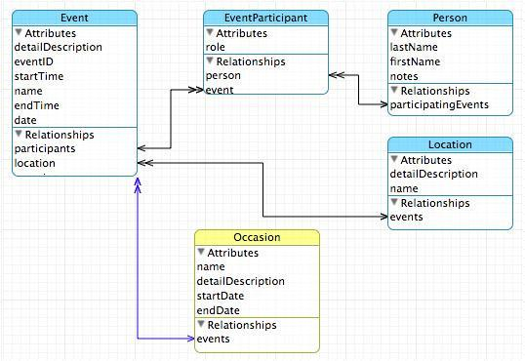

Slide 4
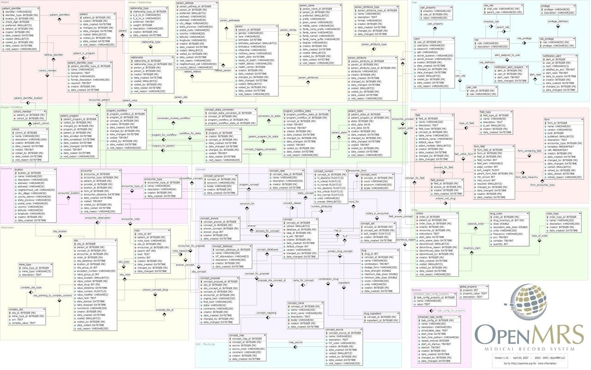

Slide 5
Building a Data Model
Drawing a picture of the data objects for our application and then figuring out how to represent the objects and their relationships
Basic Rule: Don’t put the same string data in twice - use an additional table and a foreign key instead
When there is one thing in the “real world” there should be one copy of that thing in the database

Slide 6
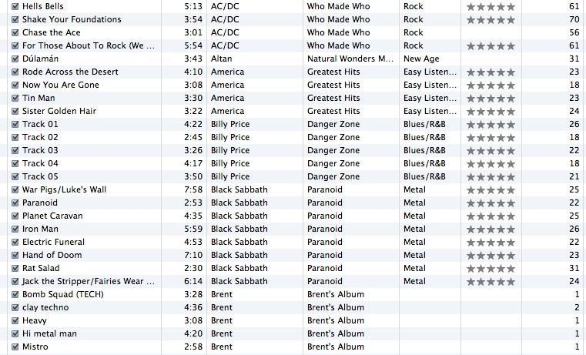
Track
Len
Artist
Album
Genre
Rating
Count
A "Data Set"

Slide 7
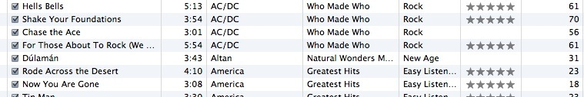
For each “piece of info”...
Is the column an object or an attribute of another object?
Once we define objects, we need to define the relationships between objects
Len
Album
Genre
Artist
Rating
Track
Count

Slide 8
Track
Album
Artist
Genre
Rating
Len
Count

Slide 9
Track
Rating
Len
Count
Track
Artist
Album
belongs-to
Artist
Album
Genre
belongs-to
Rating
Len
Genre
belongs-to
Count

Slide 10
Track
Rating
Len
Count
Artist
belongs-to
Album
belongs-to
Genre
belongs-to

Slide 11
Representing Relationships in a Database

Slide 12
Database Normalization (3NF)
There is *tons* of database theory - way too much to understand without excessive predicate calculus
Do not replicate data - reference data - point at data
Use integers for keys and for references
Add a special “key” column to each table which we will make references to. By convention, many programmers call this column “id”
http://en.wikipedia.org/wiki/Database_normalization

Slide 13
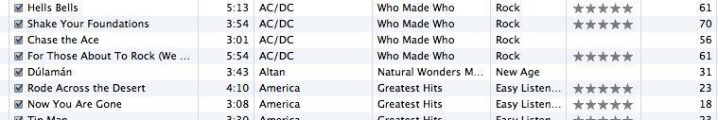
We want to keep track of which band is the “creator” of each music track...
What album does this song “belong to”??
Which album is this song related to?

Slide 14
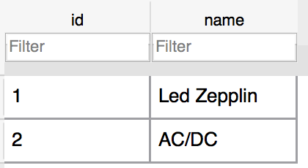
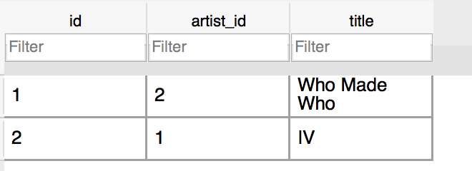
Integer Reference Pattern
Artist
We use integers to reference rows in another table
Album

Slide 15
Three Kinds of Keys
Primary key - generally an integer auto-increment field
Logical key - What the outside world uses for lookup
Foreign key - generally an integer key pointing to a row in another table
Album
id
title
artist_id
...

Slide 16
Key Rules
Best practices
Never use your logical key as the primary key
Logical keys can and do change, albeit slowly
Relationships that are based on matching string fields are less efficient than integers
User
id
login
password
name
email
created_at
modified_at
login_at

Slide 17
Foreign Keys
A foreign key is when a table has a column that contains a key which points to the primary key of another table.
When all primary keys are integers, then all foreign keys are integers - this is good - very good
Album
id
title
artist_id
...
Artist
id
name
...

Slide 18
Relationship Building (in tables)

Slide 19
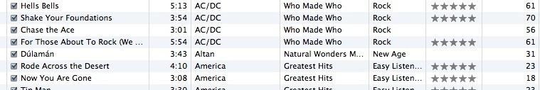
Artist
Track
Rating
Len
Count
belongs-to
Album
belongs-to
Genre
belongs-to

Slide 20
belongs-to
Track
Album
Title
Rating
Track
Len
Count
id
title
Album
rating
Table
Primary key
Logical key
Foreign key
id
len
title
count
album_id

Slide 21
Artist
Track
id
Album
id
name
id
title
title
rating
Table
Primary key
Logical key
Foreign key
artist_id
len
count
album_id
Genre
genre_id
id
Naming FK artist_id is a convention
name

Slide 22
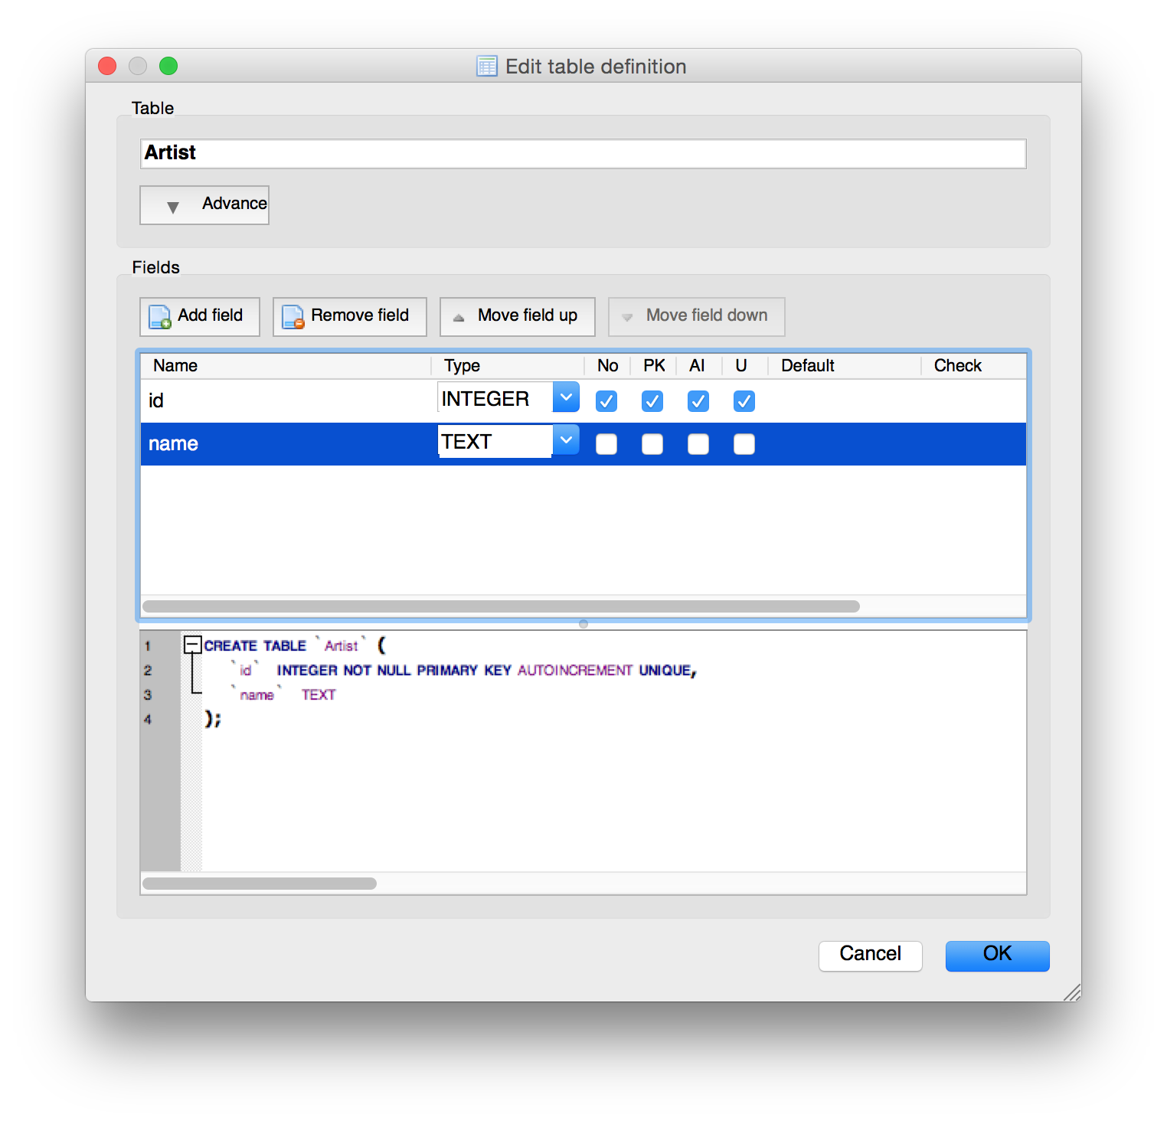

Slide 23
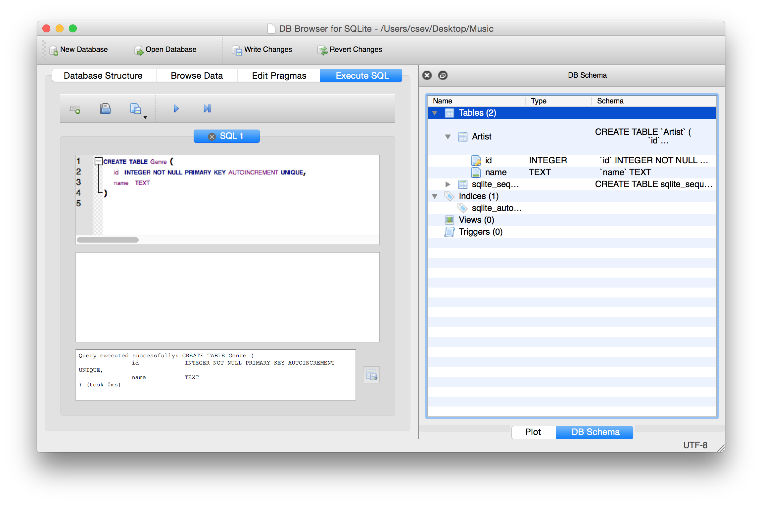
CREATE TABLE Genre (
id INTEGER NOT NULL PRIMARY KEY AUTOINCREMENT UNIQUE,
name TEXT
)

Slide 24
CREATE TABLE Album (
id INTEGER NOT NULL PRIMARY KEY AUTOINCREMENT UNIQUE,
artist_id INTEGER,
title TEXT
)
CREATE TABLE Track (
id INTEGER NOT NULL PRIMARY KEY AUTOINCREMENT UNIQUE,
title TEXT,
album_id INTEGER,
genre_id INTEGER,
len INTEGER, rating INTEGER, count INTEGER
)

Slide 25
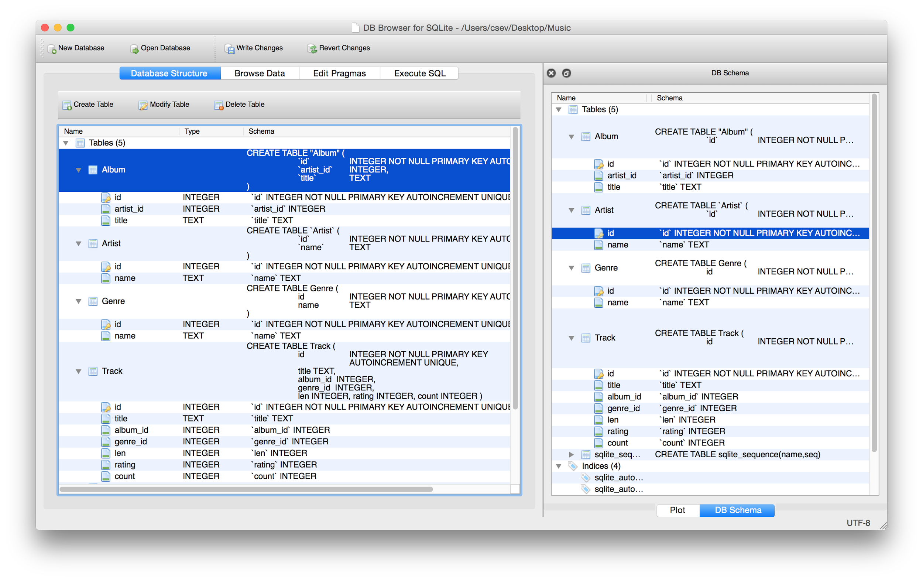

Slide 26
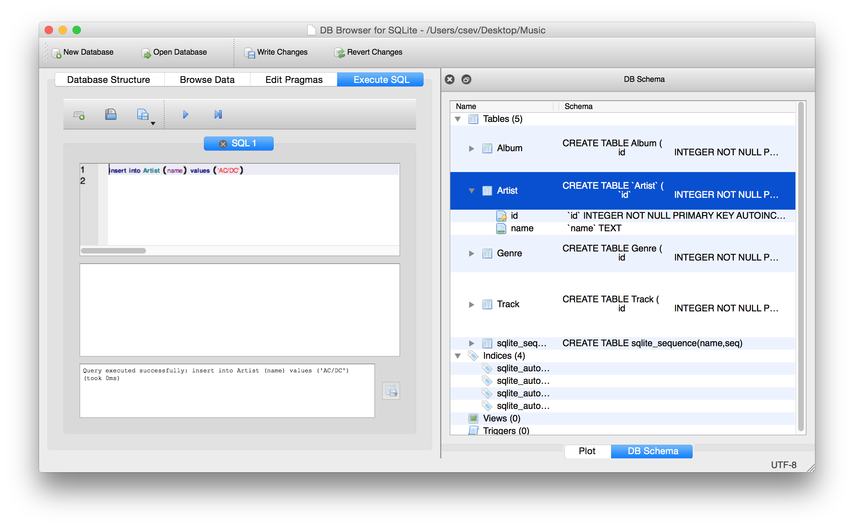
insert into Artist (name) values ('Led Zepplin')
insert into Artist (name) values ('AC/DC')

Slide 27
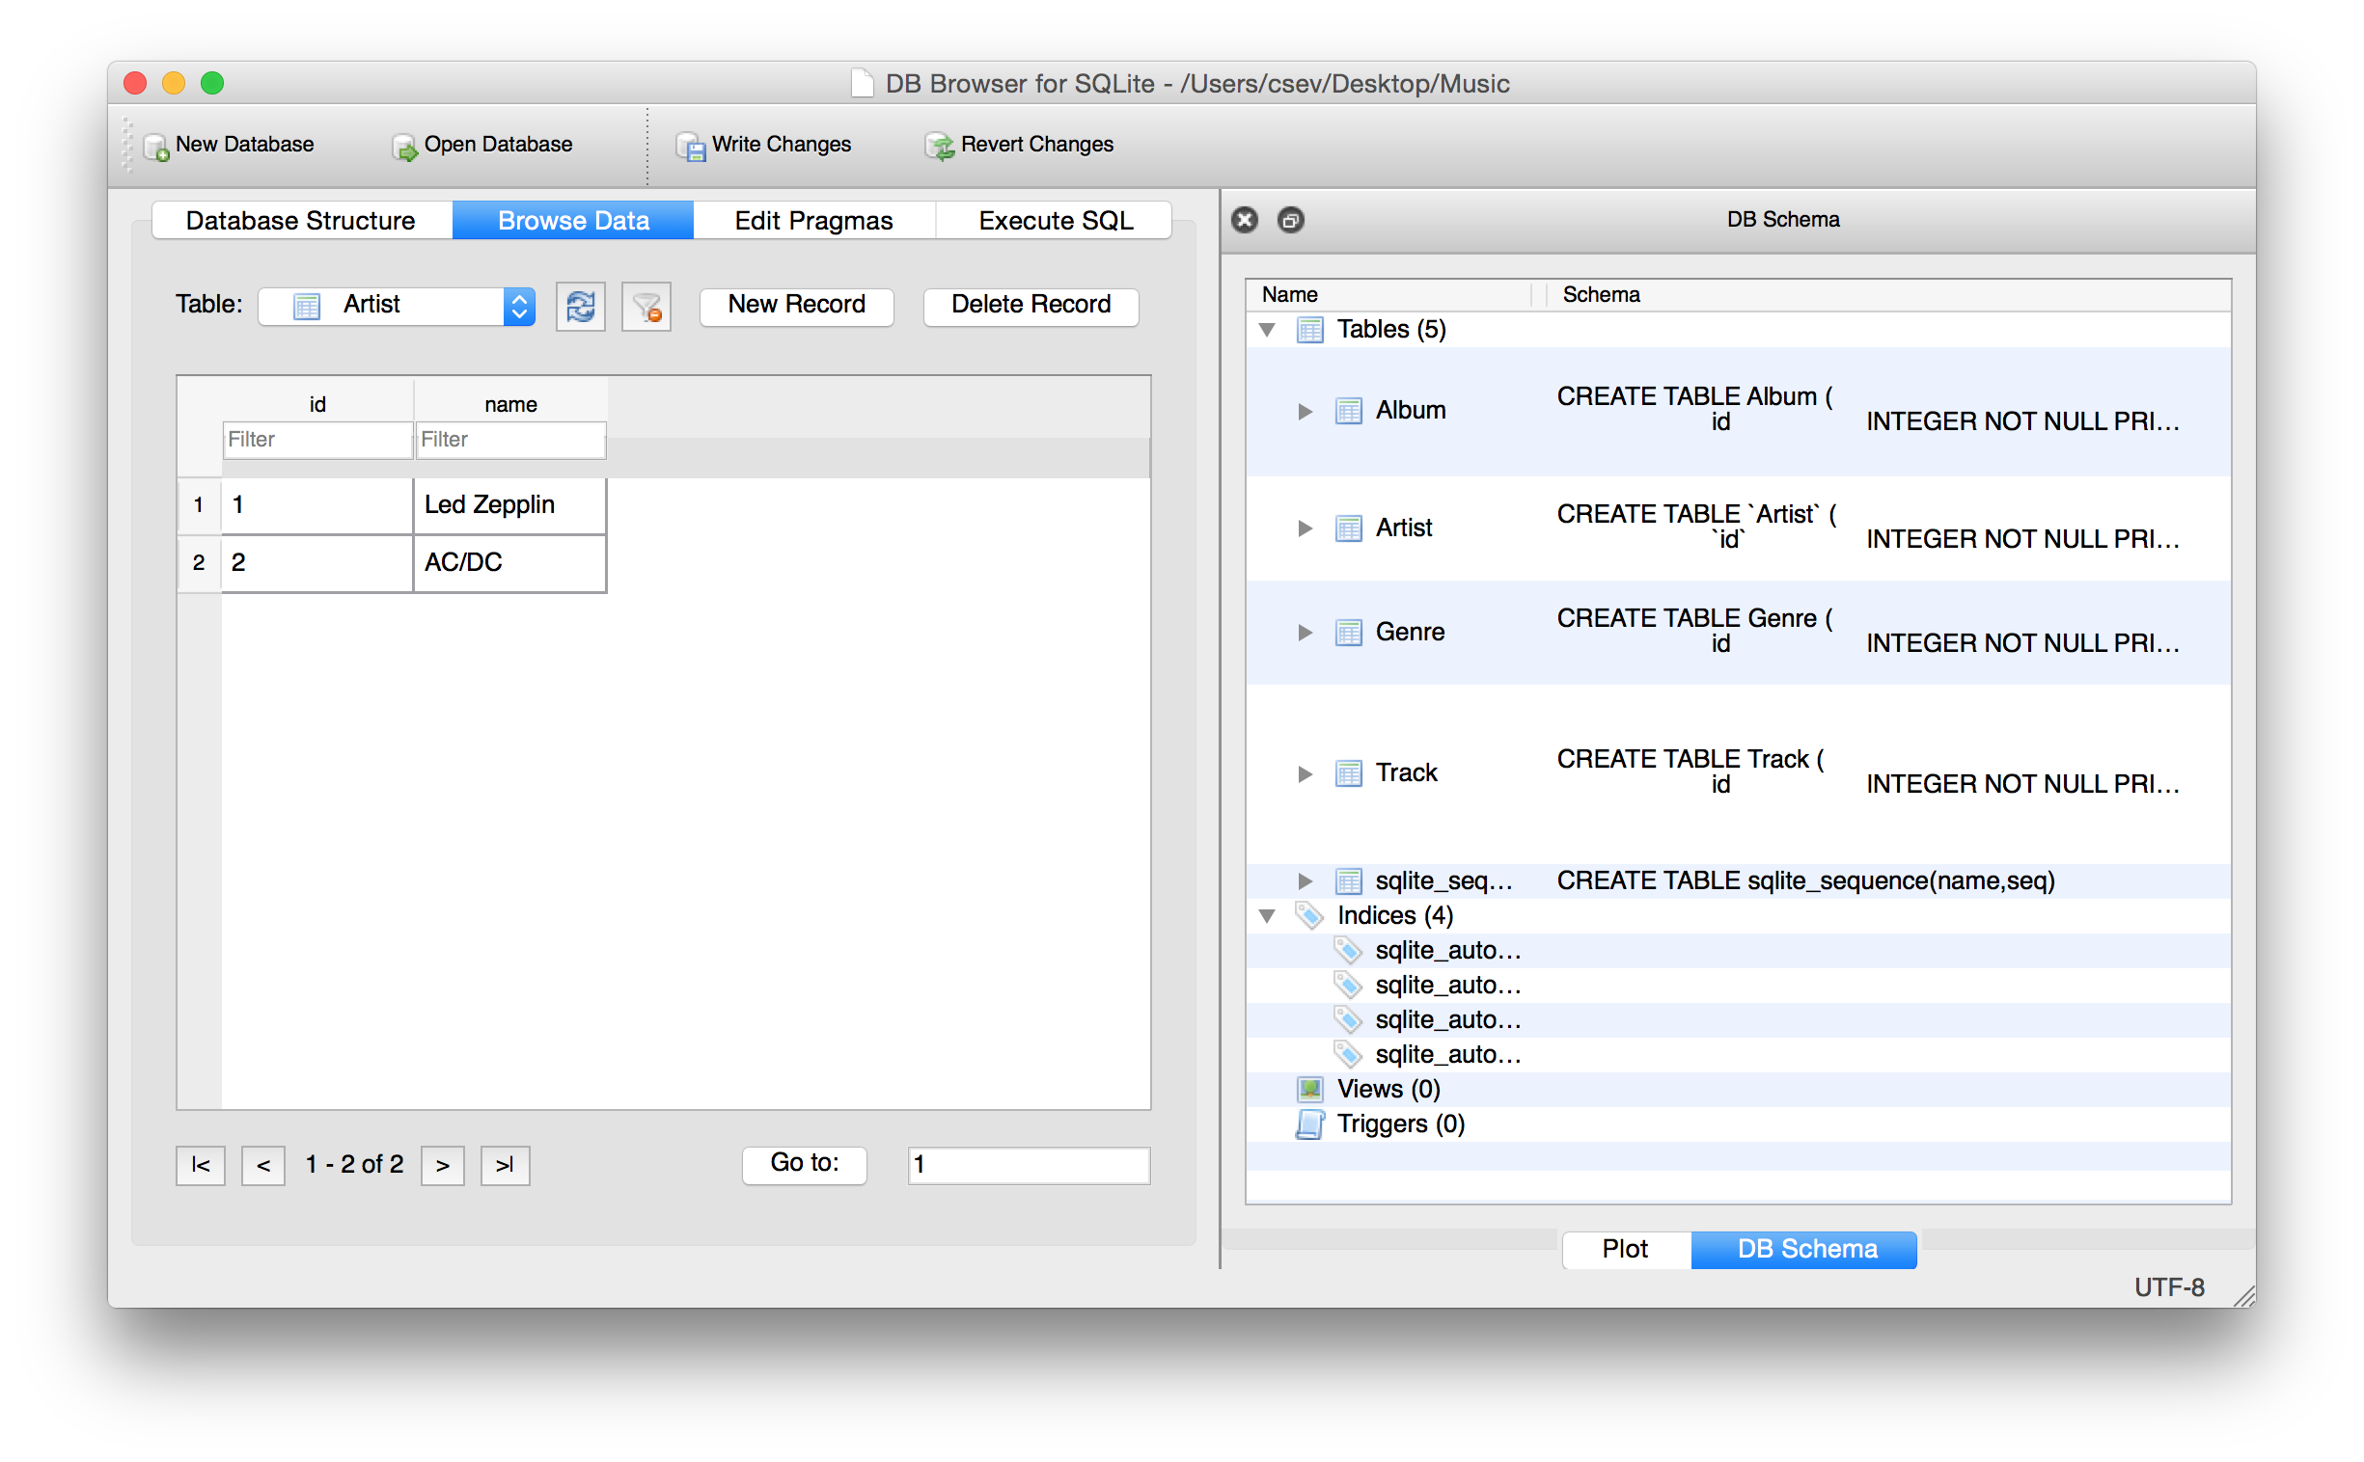

insert into Artist (name) values ('Led Zepplin')
insert into Artist (name) values ('AC/DC')

Slide 28
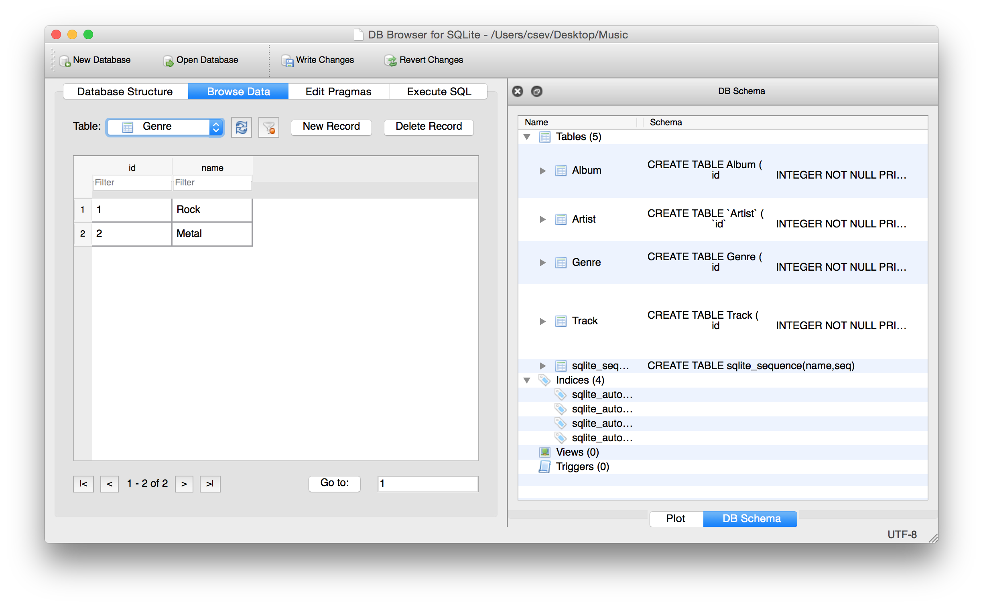
insert into Genre (name) values ('Rock')
insert into Genre (name) values ('Metal')

Slide 29
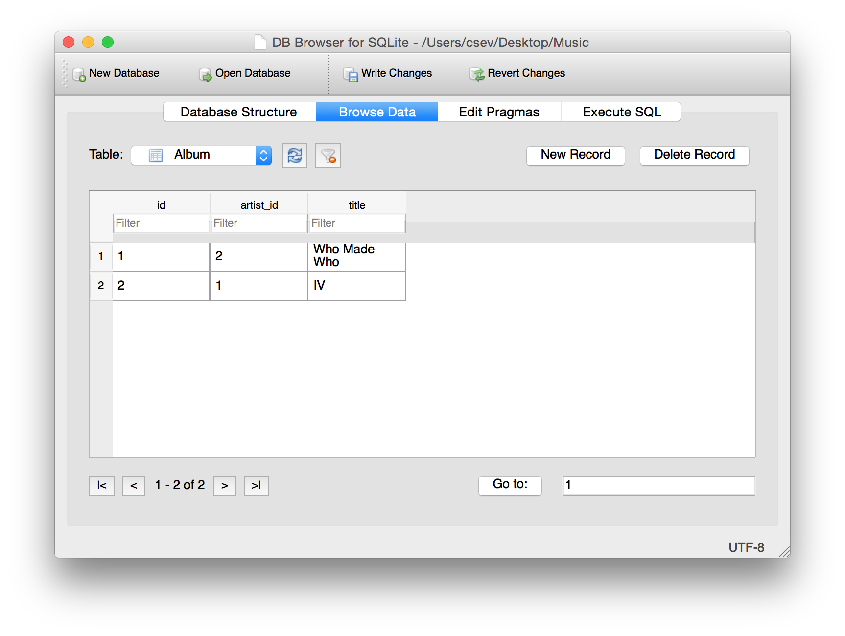
insert into Album (title, artist_id) values ('Who Made Who', 2)
insert into Album (title, artist_id) values ('IV', 1)

Slide 30
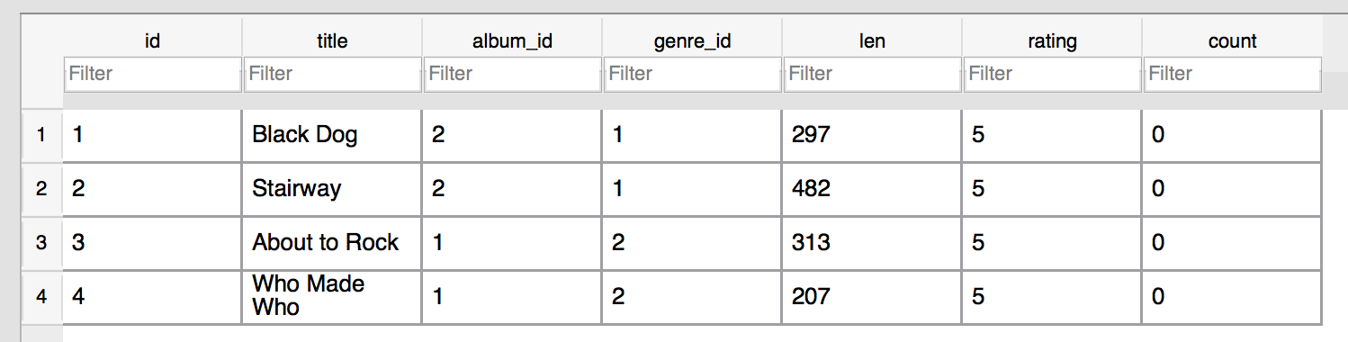
insert into Track (title, rating, len, count, album_id, genre_id)
values ('Black Dog', 5, 297, 0, 2, 1)
insert into Track (title, rating, len, count, album_id, genre_id)
values ('Stairway', 5, 482, 0, 2, 1)
insert into Track (title, rating, len, count, album_id, genre_id)
values ('About to Rock', 5, 313, 0, 1, 2)
insert into Track (title, rating, len, count, album_id, genre_id)
values ('Who Made Who', 5, 207, 0, 1, 2)

Slide 31
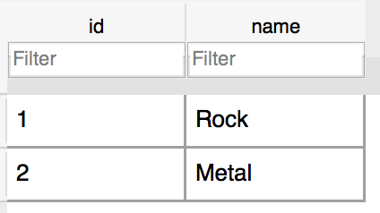
Track
Album
Genre
Artist

Slide 32
Acknowledgements / Contributions
These slides are Copyright 2019- Charles R. Severance (www.dr-chuck.com) as part of www.dj4e.com and made available under a Creative Commons Attribution 4.0 License. Please maintain this last slide in all copies of the document to comply with the attribution requirements of the license. If you make a change, feel free to add your name and organization to the list of contributors on this page as you republish the materials.
Initial Development: Charles Severance, University of Michigan School of Information
Insert new Contributors and Translators here including names and dates
Continue new Contributors and Translators here

